Slide 1

Network & System Administration
Networking Fundamentals

Slide 2
Agenda
Week | 1st Week
Day
Duration | 4hrs
TIME | TOPIC & ACTIVITY | CPMPLETED-
30 Mins | Networking Fundamentals. | Yes/No
60 Mins | TCP/IP protocol suite. | Yes/No
15 Mins | Break | Yes/No
45 Mins | Network architecture and topologies. | Yes/No
30 Mins | Q&A Session on lesson learnt | Yes/No
15 Mins | Break | Yes/No
60 Mins | IP addressing and subnetting. | Yes/No
15 Mins | Group Discussion | Yes/No

Slide 3
Learning Objectives
2.0 Networking Fundamentals.
2.1 TCP/IP protocol suite.
2.2 Network architecture and topologies.
2.3 IP addressing and subnetting.

Slide 4
2.0 Introduction to Networking Fundamentals

Slide 5
In the modern era of computing, networking plays a pivotal role in connecting devices, systems, and users, facilitating communication, data exchange, and resource sharing
These are some overviews of its importance:
Access to Information
Through networking, by access or browsing users can gain a large amount of information available on the internet and other networked resources.
Data Communication
Networking enables the communication of data between devices and systems, enabling real-time communication and collaboration.
Resource Sharing
: Networking allows sharing of resources such as printers, storage devices, and software applications.
Networking enables connectivity global, allowing devices and users from different geographical locations to communicate seamlessly.
Global Connectivity
Networking is essential for the smooth operation of businesses, enabling functions such as online transactions, inventory management, customer relationship management (CRM), and supply chain management.
Business Operations
With the proliferation of networking, ensuring the security and privacy of data has become paramount.
Security and Privacy

Slide 6
2.1TCP/IP Protocol Suite

Slide 7

What is TCP/IP?
A collection of networking protocols known as TCP/IP, or Transmission Control Protocol/Internet Protocol, regulates data exchange between devices linked to networks, including the internet. It serves as the basis for data transmission in a significant portion of global computer networks.

Slide 8
Historical background and development of a TCP/IP
Birth of TCP/IP (1970s):
The most popular network protocol in the world, TCP/IP protocol suite, was designed in 1970s by 2 DARPA scientists—Vint Cerf and Bob Kahn, people most often called the fathers of the Internet.
In the spring of 1973, they started by conducting research on reliable data communications across packet radio networks, factored in lessons learned from the Networking Control Protocol, and then created the next generation Transmission Control Protocol (TCP), the standard protocol used on the Internet today.
https://en.wikipedia.org/wiki/Internet_protocol_suite

Slide 9
Descripting TCP/IP
Transmission Control Protocol (TCP):
Within the TCP/IP suite, TCP is one of the primary protocols.
It guarantees that data packets are sent on a network in a dependable and structured method between devices.
TCP breaks data into smaller packets and attaches error-checking data, sequencing information, and other information to each packet.
It controls the flow of data, handles retransmissions in the event of packet loss or mistakes, and makes sure the data reaches its destination secure and in the right order.
Internet Protocol (IP):
IP is another fundamental protocol in the TCP/IP suite.
It provides the addressing and routing mechanism for packets of data to be transmitted across networks.
IP assigns a unique numerical address (IP address) to each device connected to a network, allowing data to be routed to its intended destination.
It also defines how packets are formatted and transmitted, including specifications for packet headers, addressing, and fragmentation.

Slide 10
Structured Layers of a TCP/IP
Each layer responsible for specific aspects of data transmission and networking functionality. TCP/IP protocol is organized in four layers.
Application Layer
This layer includes protocols such as HTTP, FTP, SMTP, and DNS, which govern high-level communication between applications running on different devices.
Transport Layer
TCP and UDP operate at this layer, providing end-to-end communication services for data exchange between devices. TCP ensures reliable, connection-oriented communication, while UDP offers faster, connectionless communication.
Internet Layer
The Internet Protocol (IP) operates at this layer, handling the routing of packets across interconnected networks. It determines the best path for data transmission and forwards packets between devices.
Also known as the Network Interface Layer or Data Link Layer, this layer deals with the physical connection between devices and the local network. It includes protocols such as Ethernet and Wi-Fi, which govern the transmission of data over specific network mediums
Link Layer

Slide 11
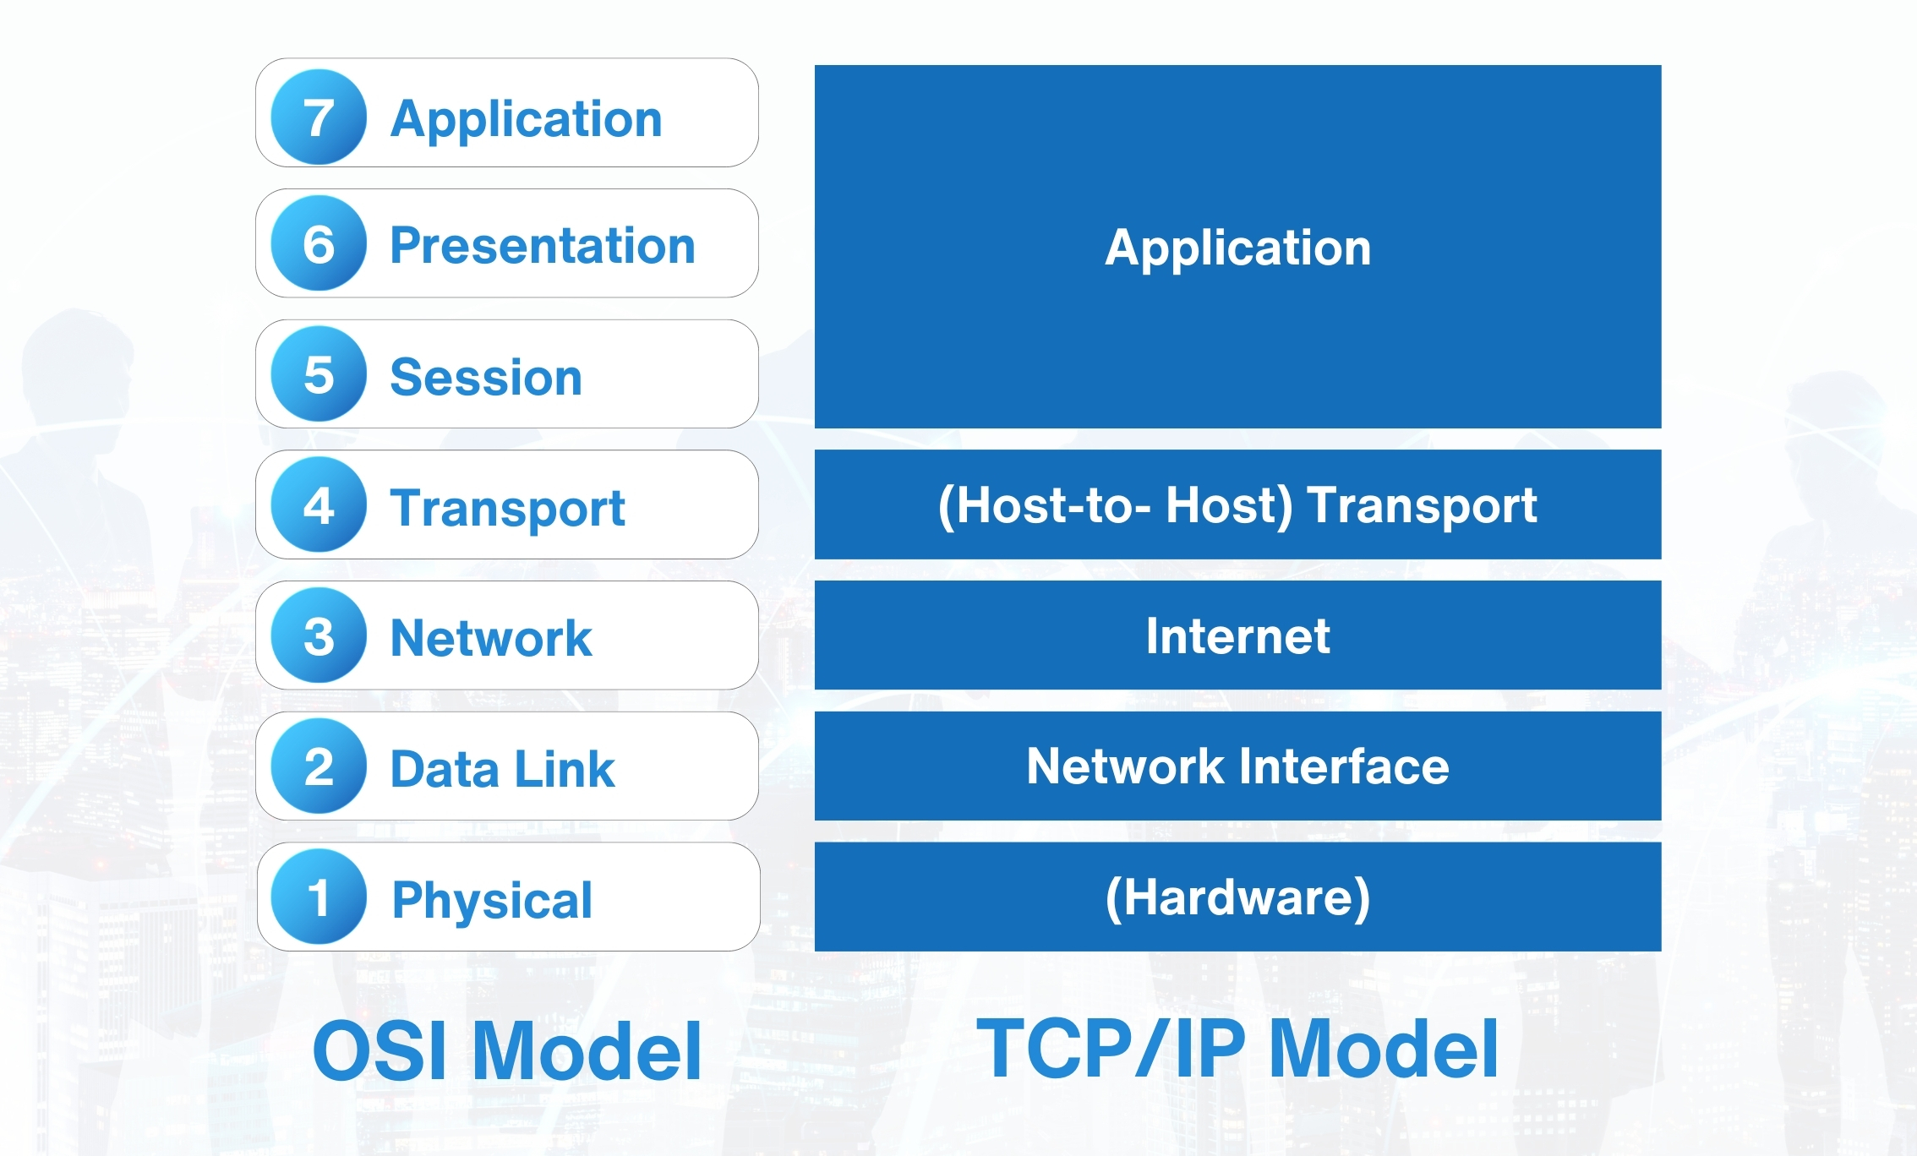
Comparison of TCP/IP and OSI Model Transmission
Referring to the area.
https://www.geeksforgeeks.org/tcp-ip-model/

Slide 12
Importance of TCP/IP in modern networking
Support for Various Applications
Standardization and Interoperability
Reliable Data Transmission
Scalability and Flexibility
Security and Privacy
Support for Emerging Technologies
Refer Sites
https://coimbatorewebhosting.com/blog/importance-of-tcpip-in-computer-networking/
https://www.geeksforgeeks.org/tcp-ip-in-computer-networking/

Slide 13


Slide 14
2.2 Network architecture and topologies

Slide 15
Overview of network architecture Local Area Network (LAN)
Local Area Network (LAN):
Definition: A LAN is a network that spans a relatively small geographic area, such as a single building, office, or campus.
Scope: LANs are typically used to connect devices within a limited area, allowing for local communication and resource sharing.
Topology: LANs can be implemented using various topologies, including star, bus, ring, or mesh.
Connectivity: Devices within a LAN are typically connected using Ethernet cables, Wi-Fi, or other local networking technologies.
Applications: LANs are commonly used in homes, businesses, schools, and other environments to facilitate communication, file sharing, printing, and access to shared resources.
Examples: Home networks, office networks, campus networks

Slide 16
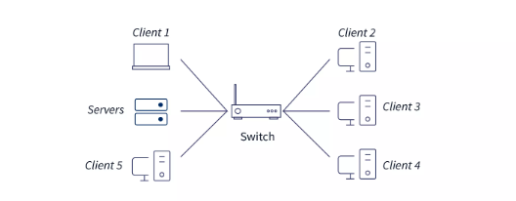
Local Area Network (LAN)

Slide 17
Overview of Network Architecture Wide Area Network (WAN)
Wide Area Network (WAN):
Definition: A WAN is a network that spans a large geographic area, connecting multiple LANs and other networks over long distances.
Scope: WANs enable communication between devices located in different cities, countries, or continents, often using public or private telecommunications infrastructure.
Topology: WANs typically use point-to-point or multipoint connections between geographically dispersed locations.
Connectivity: WANs utilize various technologies for long-distance communication, including leased lines, fiber-optic cables, satellite links, and internet connections.
Applications: WANs support a wide range of applications, including internet access, email, video conferencing, cloud computing, and remote access to resources.
Examples: The internet, private wide area networks operated by businesses or organizations, global networks connecting multiple offices or branches.

Slide 18
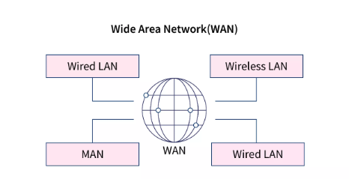
Wide Area Network (WAN)

Slide 19
Overview of network architecture Metropolitan Area Network (MAN)
Metropolitan Area Network (MAN):
Definition: A MAN is a network that spans a metropolitan area, such as a city or urban region, providing connectivity between multiple LANs and WANs.
Scope: MANs bridge the gap between LANs and WANs, offering high-speed communication within a city or metropolitan area.
Topology: MANs may use a variety of network topologies, depending on the specific requirements of the urban environment and the infrastructure available.
Connectivity: MANs often rely on fiber-optic cables, microwave links, or other high-speed technologies to connect different locations within the metropolitan area.
Applications: MANs support applications that require high-bandwidth and low-latency connectivity over shorter distances, such as video surveillance, municipal services, and data centers.
Examples: City-wide Wi-Fi networks, cable television networks, university campus networks, public transportation networks.

Slide 20
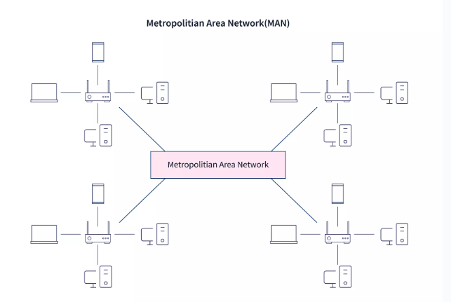
Metropolitan Area Network (MAN)

Slide 21
Difference between LAN vs MAN vs WAN

Slide 22
Introduction to Network Devices
What are the network devices and the Functions?
Routers:-
The main job of a router is to direct traffic. Routers transfer packets to their destinations by charting a path through interconnected networking devices using different network topologies.
Switches:-
A switch is a multiport device that improves network efficiency. Switches maintain limited routing information about nodes in the internal network, allowing connections to systems like hubs or routers. Strands of LANs are usually connected using switches. Generally, switches read the hardware addresses of incoming packets to transmit them to the appropriate destination.
Bridges:-
Bridges connect two or more hosts or network segments by storing or hosting frames between them. Bridges use hardware MAC addresses for transferring frames. They can forward or block data with the MAC address of the devices connected to each segment.

Slide 23
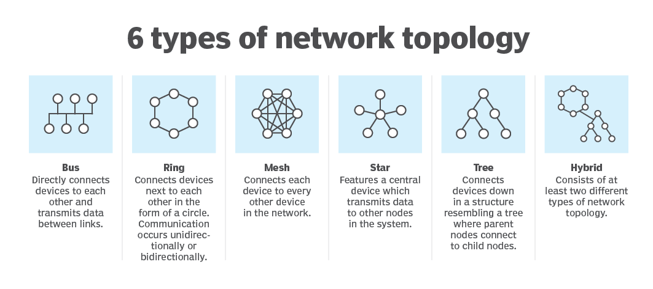
Network Topologies

Slide 24
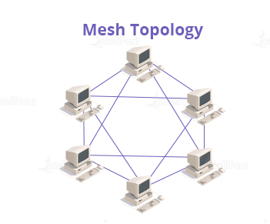
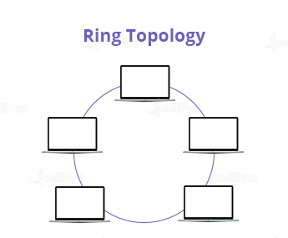
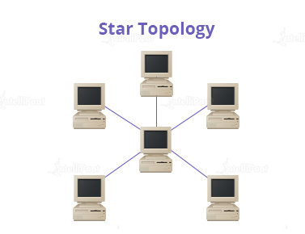
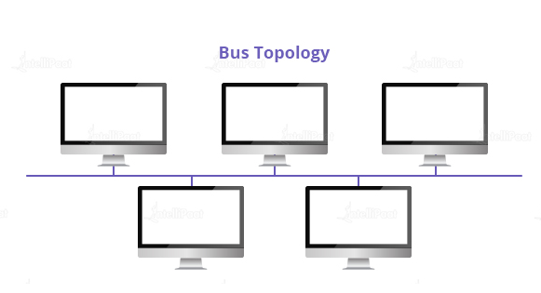
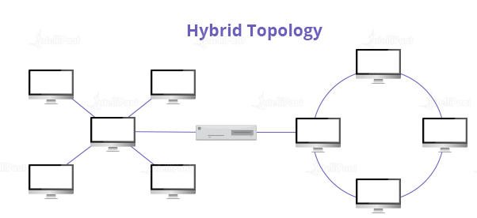
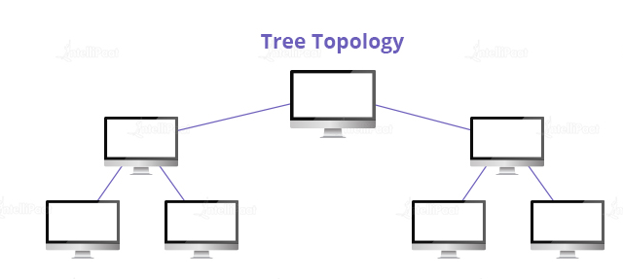
6 Types of Network Topologies

Slide 25
Network topologies
What are the advantages and disadvantages of each topology?

Slide 26
Q&Q Session on Lesson learned

Slide 27
Q&Q Session
Q1: What is the TCP/IP protocol suite?
A1: The TCP/IP protocol suite is a set of communication protocols used for the Internet and similar networks. It is named after two of its primary protocols: Transmission Control Protocol (TCP) and Internet Protocol (IP).
Q2: What are the main layers of the TCP/IP protocol suite?
A: The TCP/IP protocol suite consists of four layers:
Application Layer: Includes protocols like HTTP, FTP, SMTP, which provide specific data communication services.
Transport Layer: Includes TCP and UDP, which provide end-to-end communication services.
Internet Layer: Includes IP, ICMP, ARP, which handle addressing and routing of packets.
Network Interface Layer: Manages the physical transmission of data over network hardware.

Slide 28
Q&Q Session
Q3: What are the main types of network topologies?
A3: The main types of network topologies include:
Bus Topology: All devices share a single communication line or bus.
Star Topology: All devices are connected to a central hub.
Ring Topology: Devices are connected in a circular fashion.
Mesh Topology: Devices are interconnected, with multiple pathways for data.
Tree Topology: A hierarchical topology with a root node and branches.
Hybrid Topology: A combination of two or more different types of topologies.

Slide 29
Q&Q Session
Q4: How does subnetting benefit a network?
A4: Subnetting can:
Reduce network congestion by limiting broadcast domains.
Improve security by isolating parts of the network.
Enhance performance by reducing the size of routing tables.
Allow better utilization of IP address spaces by dividing a larger network into smaller sub-networks.

Slide 30


Slide 31
2.3 IP Addressing and Subnetting

Slide 32
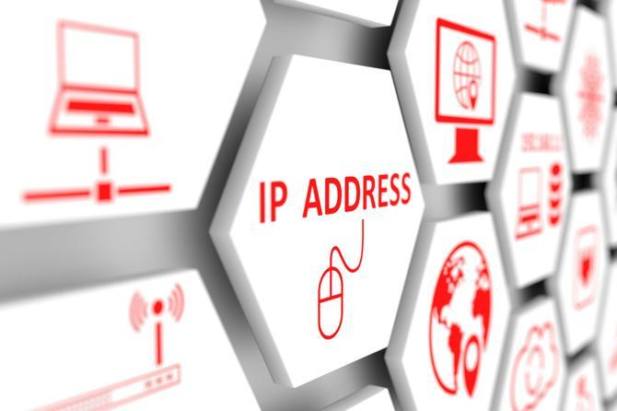
IP Addressing
What is an IP address?
All the computers of the world on the Internet network communicate with each other with underground or underwater cables or wirelessly. If I want to download a file from the internet or load a web page or literally do anything related to the internet, my computer must have an address so that other computers can find and locate mine to deliver that file or webpage that I am requesting. In technical terms, that address is called IP Address or Internet Protocol Address.
https://www.youtube.com/watch?v=hR2FErUhwPg&t=8s

Slide 33
Summary of Differences & Compared with IPv4 IPv6

Slide 34
What is an IP class and what are the class?
In the IPv4 IP address space, there are five classes: A, B, C, D and E. Each class has a specific range of IP addresses (and ultimately dictates the number of devices you can have on your network). Primarily, class A, B, and C are used by most devices on the Internet. Class D and class E are for special uses.

Slide 35
Subnetting
Subnetting is the process of creating a subnetwork (also known as a subnet) within a network. Network interfaces and devices within a subnet can communicate with each other directly. Routers facilitate communication between different subnets.
How to create a subnet
A subnet contains three main elements:
Network address (or) subnet ID: This is always the first address of the subnet.
Broadcast address: This is always the last address of the subnet. A packet forwarded to the broadcast address is broadcasted to all the addresses in a subnet.
Subnet mask (or) netmask: This is the bitmask used to identify the subnet of an IP address by applying bitwise AND operation with the netmask and the IP address. All the IP addresses in a subnet contain an identical most-significant bit group. This is how a router identifies the subnet of an IP address since data packets only contain the destination IP address.

Slide 36
Group Discussion
1. TCP/IP protocol suite.
2. Network architecture and topologies.
3. IP addressing and subnetting.

